Slide 1

Movie Data Analysis
Alexa L. Wittlieff
College of Science and Technology, Bellevue University
DSC530-T302: Data Exploration and Analysis (2223-1)
Dr. Neerja Sahu
March 5, 2022

Slide 2
Problem Statement
Does movie run time impact movie performance?

Slide 3
Selected Variables
Runtime
Length of the movie from start to finish in minutes
IMDB Rating
Rating from 1 to 10 of the film on the Internet Movie Database
Ratings calculated from votes by IMDB users, which may vote one time per registered user
Meta Score
Weighted average of critic and publication ratings
Gross Revenue
Income in dollars brought in by the movie excluding any costs
Released Year
Year the studio released the movie for viewing by the public

Slide 4
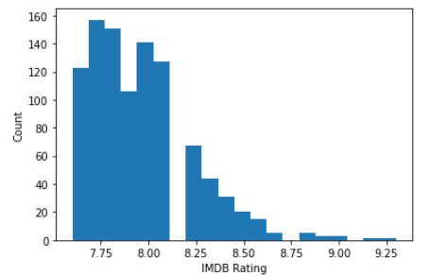
Histogram - IMDB Ratings
Most of the movies in the data set scored an IMDB Rating between 7 and 8

Slide 5
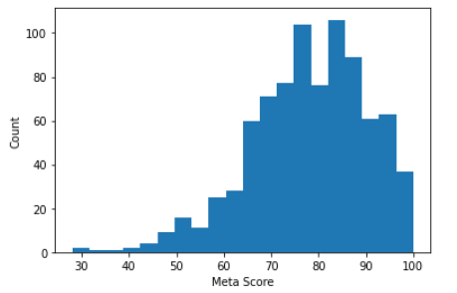
Histogram - Meta Scores
Most of the movies in the data set scored a Meta score over 65

Slide 6
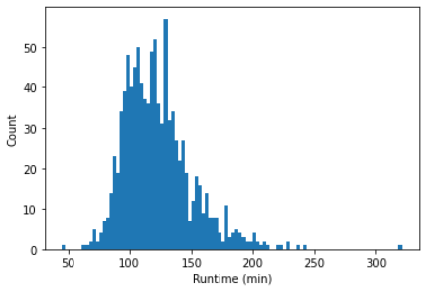
Histogram – Run Times
There are a couple of outliers for run time values
Outliers still included for analysis

Slide 7
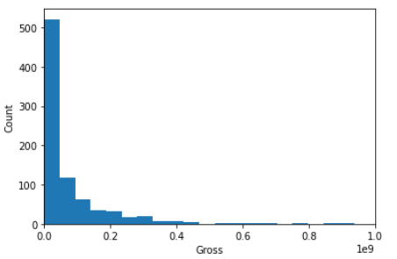
Histogram – Gross Revenue
There are a few outliers for gross revenue
Outliers still included for analysis

Slide 8
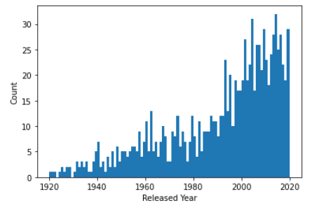
Histogram – Released Year
Movie releases experienced an uptick starting in the 1990s

Slide 9

Descriptive Statistics
Statistic | Released_Year | Runtime | IMDB_Rating | Meta_Score | Gross Revenue
Mean | 1991 | 122.89100 | 7.94930 | 77.97153 | 68034750.87
Mode | 2014 | 100 | 7.7 | 76.0 | 4360000
STD | 23.285669 | 28.093671 | 0.275491 | 12.376099 | 109750043.19

Slide 10
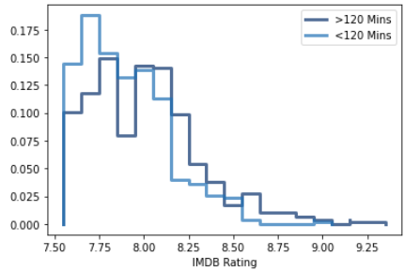
Comparing Two Scenarios
The probability mass function (PMF) maps the values of IMDB Rating to its probability. I broke apart the data to demonstrate the differences between "short" movies with run time lengths less than two hours or one hundred and twenty minutes and "long" movies with run time lengths greater than two hours or one hundred and twenty minutes. Based on the above PDF, longer movies tend to score better IMDB scores than shorter movies.

Slide 11
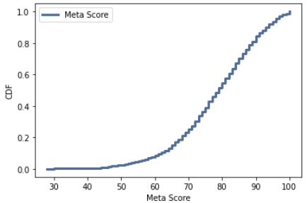
CDF of One Variable
The cumulative distribution function (CDF) maps a value to its percentile rank. The below CDF represents movie Meta Scores. Based on the CDF, approximately 50% of the movies on the IMDB top 1000 list score above an 80 meta score.

Slide 12
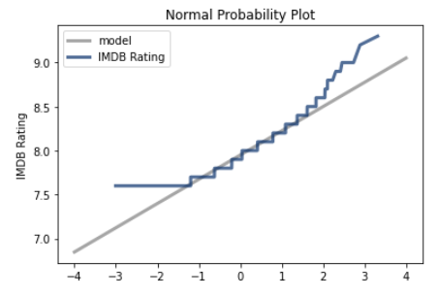
Analytical Distribution
The curve matches the model near the mean and deviates in the tails.

Slide 13
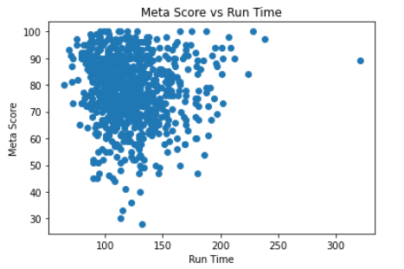
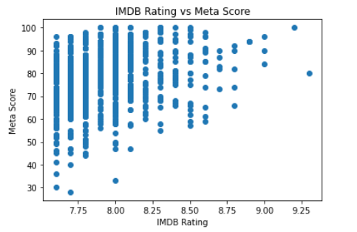
Scatter Plots Comparing Two Variables
Corr = -0.03145
Corr = 0.2685

Slide 14
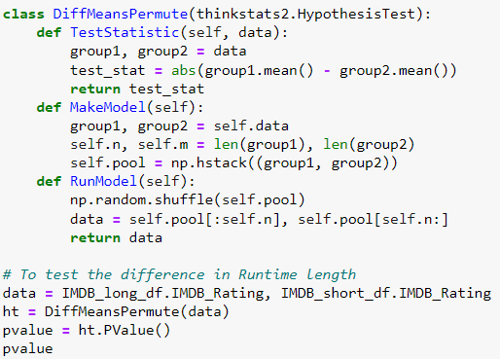
Test Hypothesis
Testing the difference in means between two groups to see if the effects of run time and IMDB rating are statistically significant.
I took the values for long movies and short movies to shuffle them.
By extracting the values as NumPy arrays and passing through DiffMeansPermute, I calculated the p-value.
The result is a p-value of 0.0, which is statistically significant.

Slide 15
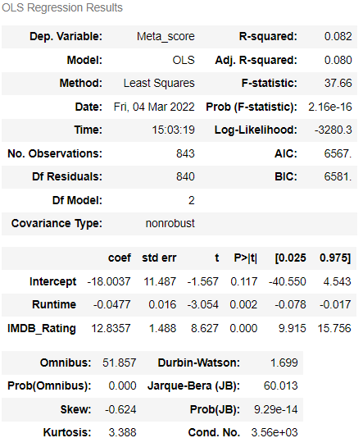
Regression Analysis
Regression model created to predict Meta score with run time and IMDB Rating
R squared value of 0.082 indicates that approximately eight percent of my variability can be explained by the model

Slide 16
Conclusion
Does movie run time impact movie performance?
Based on this initial analysis, run time does appear to correlate with movie performance.
However, correlation does not necessarily imply causation.
Additional analysis is recommended.

